Slide 1
第6章指令流水线
流水线的概念
处理器设计技术

Slide 2
Review: Single-Cycle Processor
Five steps to design a processor:
1. Analyze instruction set → datapath requirements
2. Select set of datapath components & establish clock methodology
3. Assemble datapath meeting the requirements: re-examine for pipelining
4. Analyze implementation of each instruction to determine setting of control points that effects the register transfer.
5. Assemble the control logic
Formulate Logic Equations
Design Circuits
Processor
Input
Control
Memory
Datapath
Output

Slide 3
Single Cycle Performance
Assume time for actions are
100ps for register read or write; 200ps for other events
Clock rate is?
Instr | Instr fetch | Register read | ALU op | Memory access | Register write | Total time
lw | 200ps | 100 ps | 200ps | 200ps | 100 ps | 800ps
sw | 200ps | 100 ps | 200ps | 200ps |  | 700ps
R-format | 200ps | 100 ps | 200ps |  | 100 ps | 600ps
beq | 200ps | 100 ps | 200ps |  |  | 500ps
What can we do to improve clock rate?
Will this improve performance as well?
Want increased clock rate to mean faster programs
Student Roulette?
Notes:
1.25 GHz

Slide 4
Pipeline Analogy: Doing Laundry
Ann, Brian, Cathy, Dave each have one load of clothes to wash, dry, fold, and put away
Washer takes 30 minutes
Dryer takes 30 minutes
“Folder” takes 30 minutes
“Stasher” takes 30 minutes to put clothes into drawers
A
B
C
D

Slide 5
Sequential Laundry
Sequential laundry takes 8 hours for 4 loads
6 PM
7
8
9
10
11
12
1
2 AM
T
a
s
k
O
r
d
e
r
30
30
30
30
30
30
30
30
30
30
30
30
30
30
30
30
Time
A
B
C
D

Slide 6
Pipelined Laundry
Pipelined laundry takes 3.5 hours for 4 loads!
6 PM
7
8
9
10
11
12
1
2 AM
30
30
30
30
30
Time
T
a
s
k
O
r
d
e
r
30
30
A
B
C
D

Slide 7
Pipelining Lessons (1/2)
6 PM
7
8
9
Pipelining doesn’t help latency of single task, it helps throughput of entire workload
Multiple tasks operating simultaneously using different resources
Potential speedup = Number pipe stages
Time tofillpipeline and time todrainit reduces speedup: 2.3X v. 4X in this example
T
a
s
k
O
r
d
e
r
Time
30
30
30
30
30
30
30
A
B
C
D

Slide 8
Pipelining Lessons (2/2)
6 PM
7
8
9
Suppose new Washer takes 20 minutes, new Stasher takes 20 minutes. How much faster is pipeline?
Pipeline rate limited by slowest pipeline stage
Unbalanced lengths of pipe stages reduces speedup
T
a
s
k
O
r
d
e
r
Time
30
30
30
30
30
30
30
A
B
C
D

Slide 9
Review: Single Cycle Datapath
31
26
21
16
0
op
rs
rt
immediate
Data Memory {R[rs] + SignExt[imm16]} = R[rt]
Instruction<31:0>
nPC_sel=
instr
fetch
unit
RegDst=
<21:25>
<16:20>
<0:15>
clk
<11:15>
Rd
Rt
1
0
Rs
Rt
Rd
Imm16
zero
ALUctr=
RegWr=
Rs
Rt
MemtoReg=
5
5
5
busA
32
MemWr=
busW
Rw
Ra
Rb
=
32
32
RegFile
busB
ALU
0
0
clk
32
32
WrEn
Adr
imm16
1
Data In
1
16
Extender
Data
Memory
32
clk
ExtOp=
ALUSrc=
Notes:
The store instruction performs the inverse function of the load. Instead of loading data from memory, the store instruction sends the contents of register specified by Rt to data memory.
Similar to the load instruction, the store instruction needs to read the contents of register Rs (points to Ra port) and add it to the sign extended verion of the immediate filed (Imm16, ExtOp = 1, ALUSrc = 1) to form the data memory address (ALUctr = add).
However unlike the Load instructoion where busB is not used, the store instruction will use busB to send the data to the Data memory.
Consequently, the Rt field of the instruction has to be fed to the Rb port of the register file.
In order to write the Data Memory properly, the MemWr signal has to be set to 1.
Notice that the store instruction does not update the register file. Therefore, RegWr must be set to zero and consequently control signals RegDst and MemtoReg are don’t cares.
And once again we need to set the control signals Branch and Jump to zero to ensure proper Program Counter updataing.
Well, by now, you are probably tied of these boring stuff where Branch and Jump are zero so let’s look at something different--the bracnh instruction.
+3 = 31 min. (Y:11)

Slide 10
Steps in Executing MIPS
1) IF: Instruction Fetch, Increment PC
2)ID: Instruction Decode, Read Registers
3) EX: Mem-ref: Calculate Address Arith-log:Perform Operation
4) Mem: Load: Read Data from Memory Store: Write Data to Memory
5) WB: Write Data Back to Register

Slide 11
Redrawn Single-Cycle Datapath
rd
PC
instruction
memory
registers
rs
Data
memory
rt
ALU
+4
imm
2. Decode/
Register Read
1. Instruction
Fetch
5. Write Back
3. Execute
4. Memory

Slide 12
Pipelined Datapath
rd
PC
instruction
memory
registers
rs
Data
memory
rt
ALU
+4
imm
2. Decode/
Register Read
1. Instruction
Fetch
5. Write Back
3. Execute
4. Memory
Add registers between stages
Hold information produced in previous cycle

Slide 13
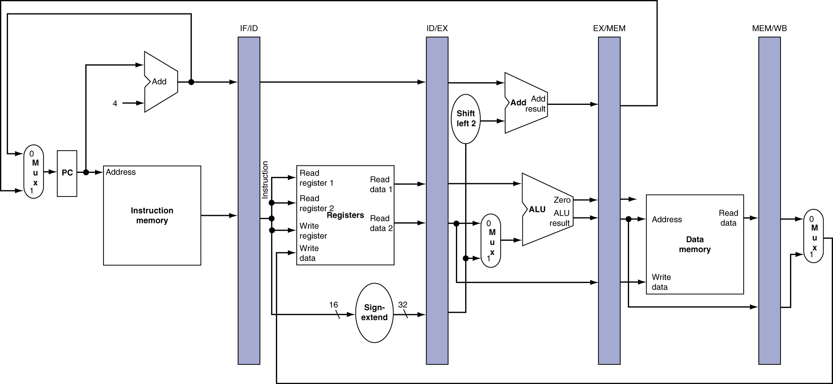
More Detailed Pipeline

Slide 14
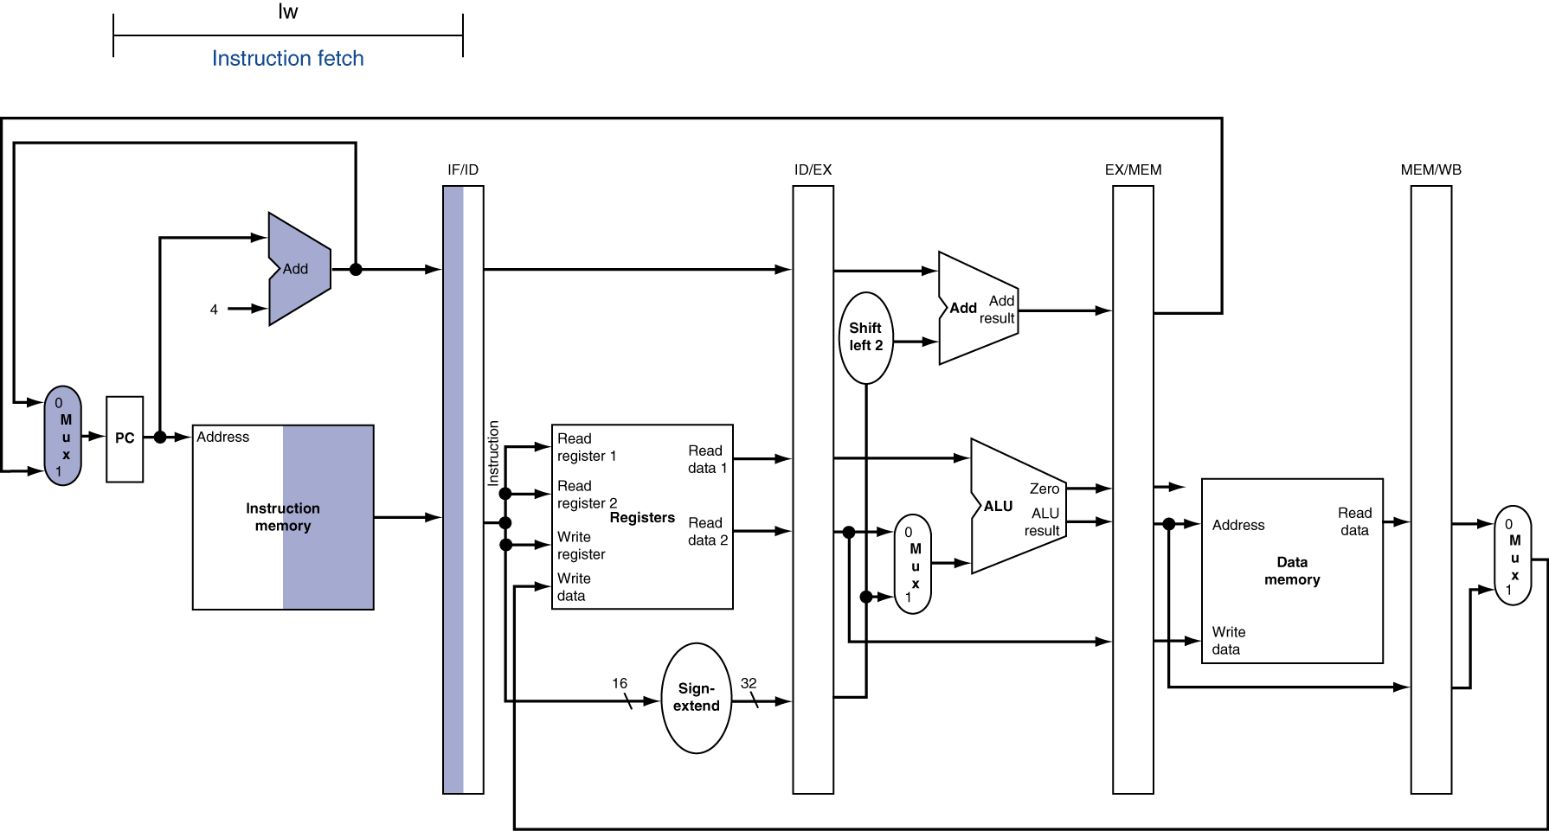
IF for Load, Store, …

Slide 15
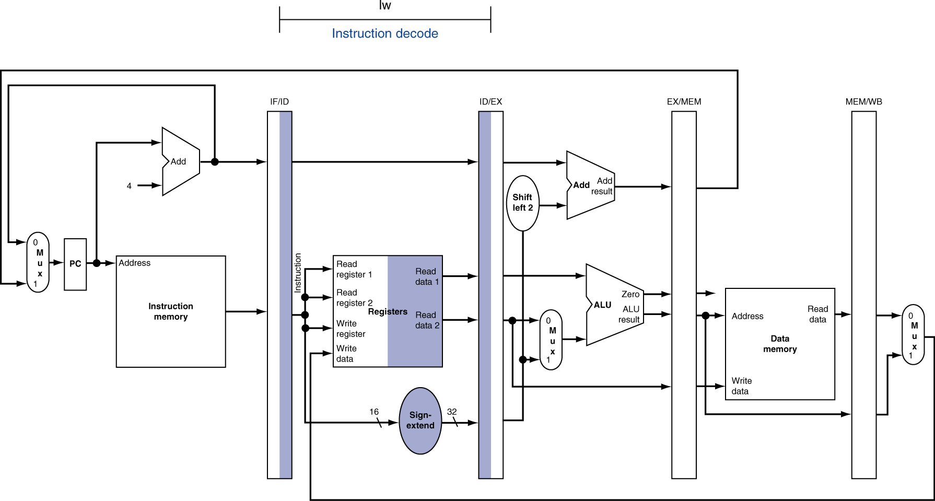
ID for Load, Store, …

Slide 16
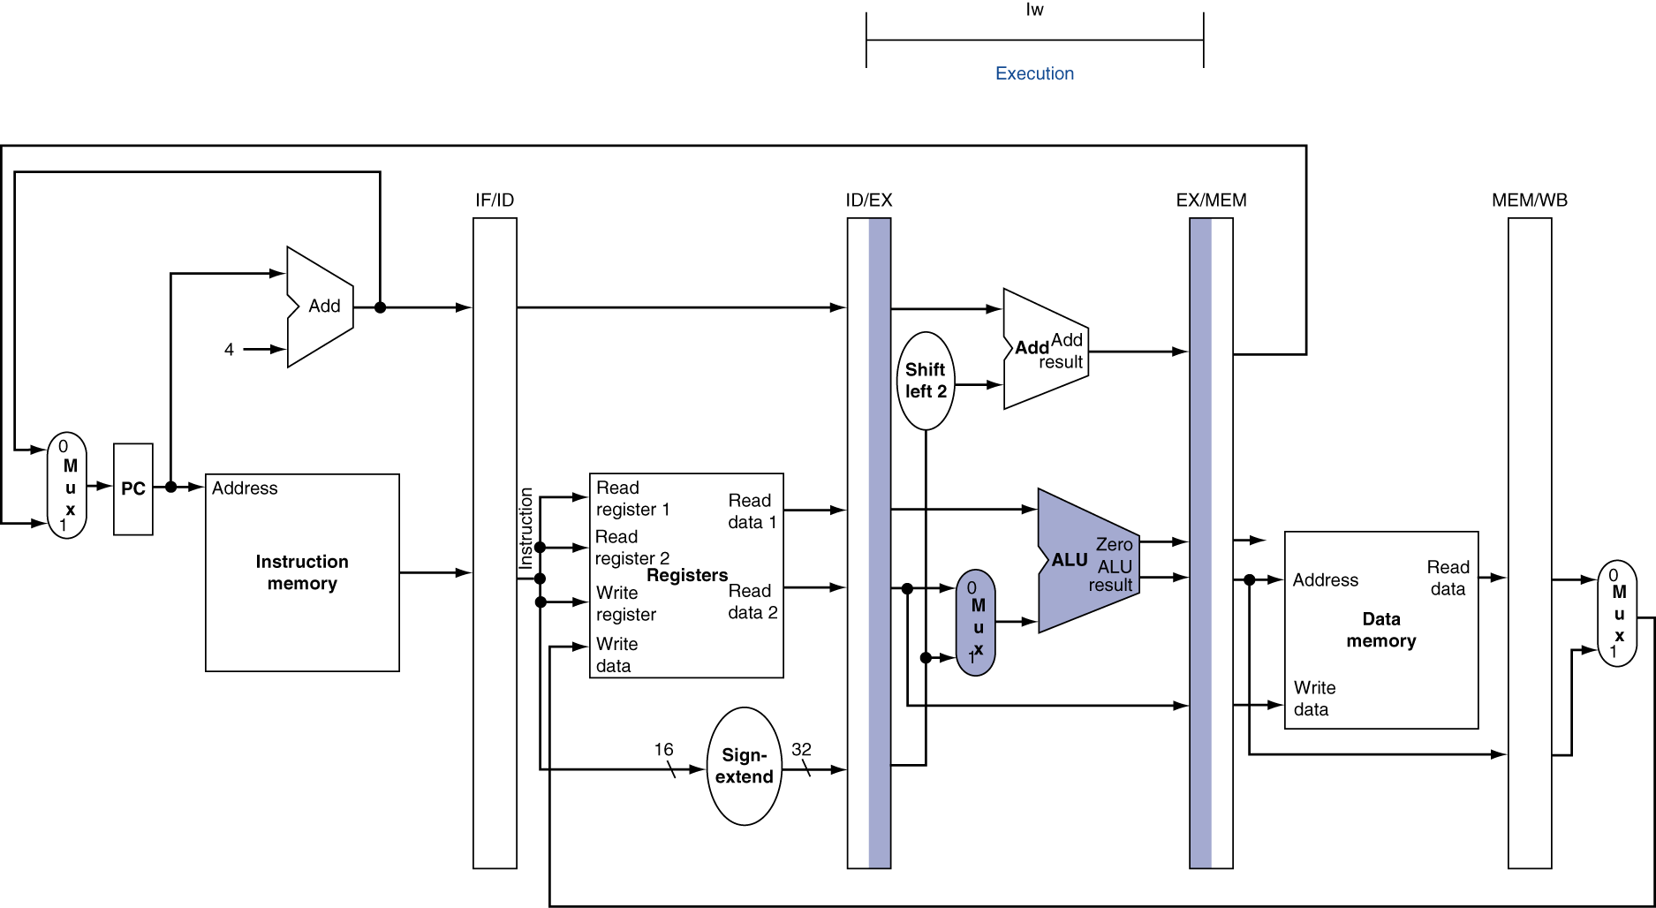
EX for Load

Slide 17
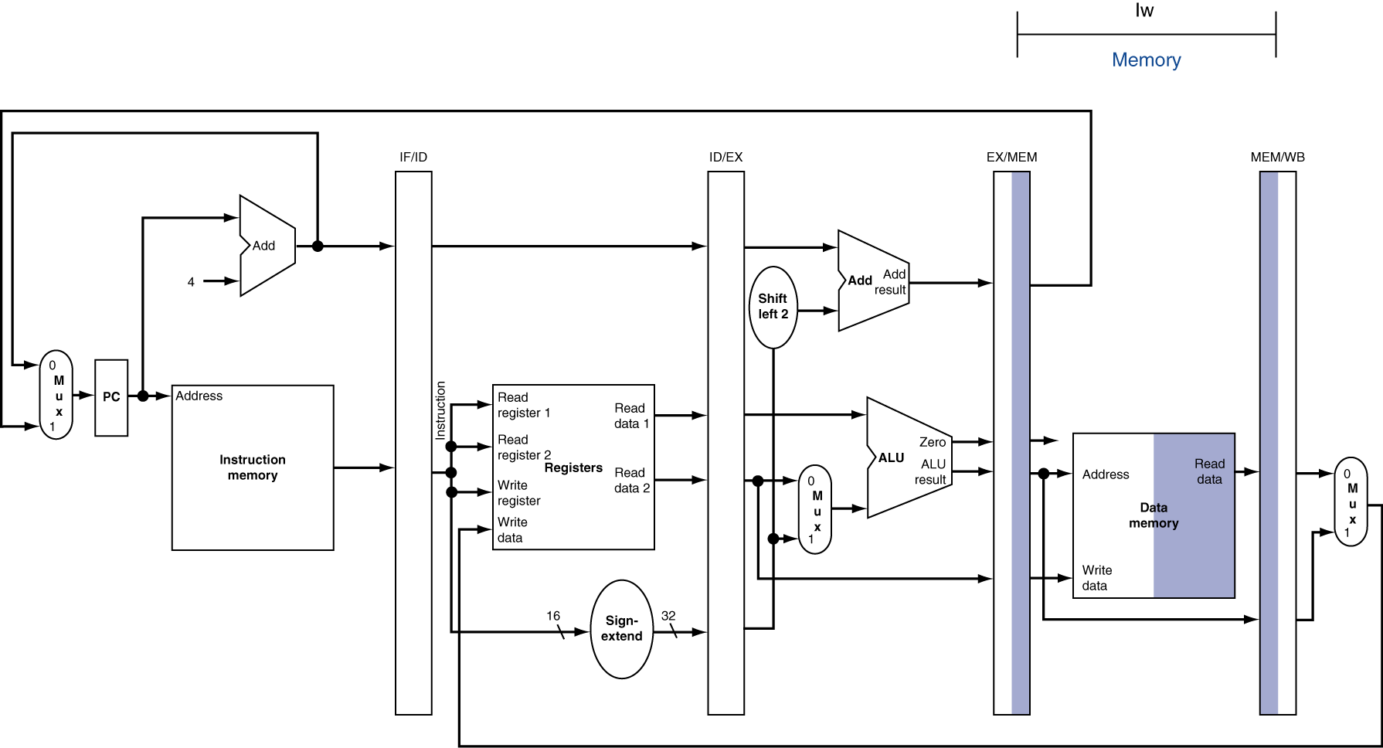
MEM for Load

Slide 18
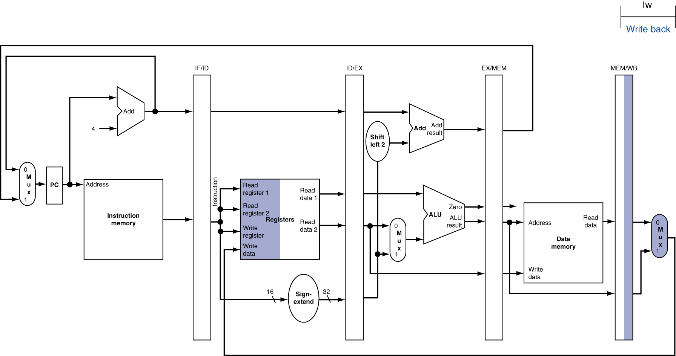
WB for Load
Wrong register number

Slide 19
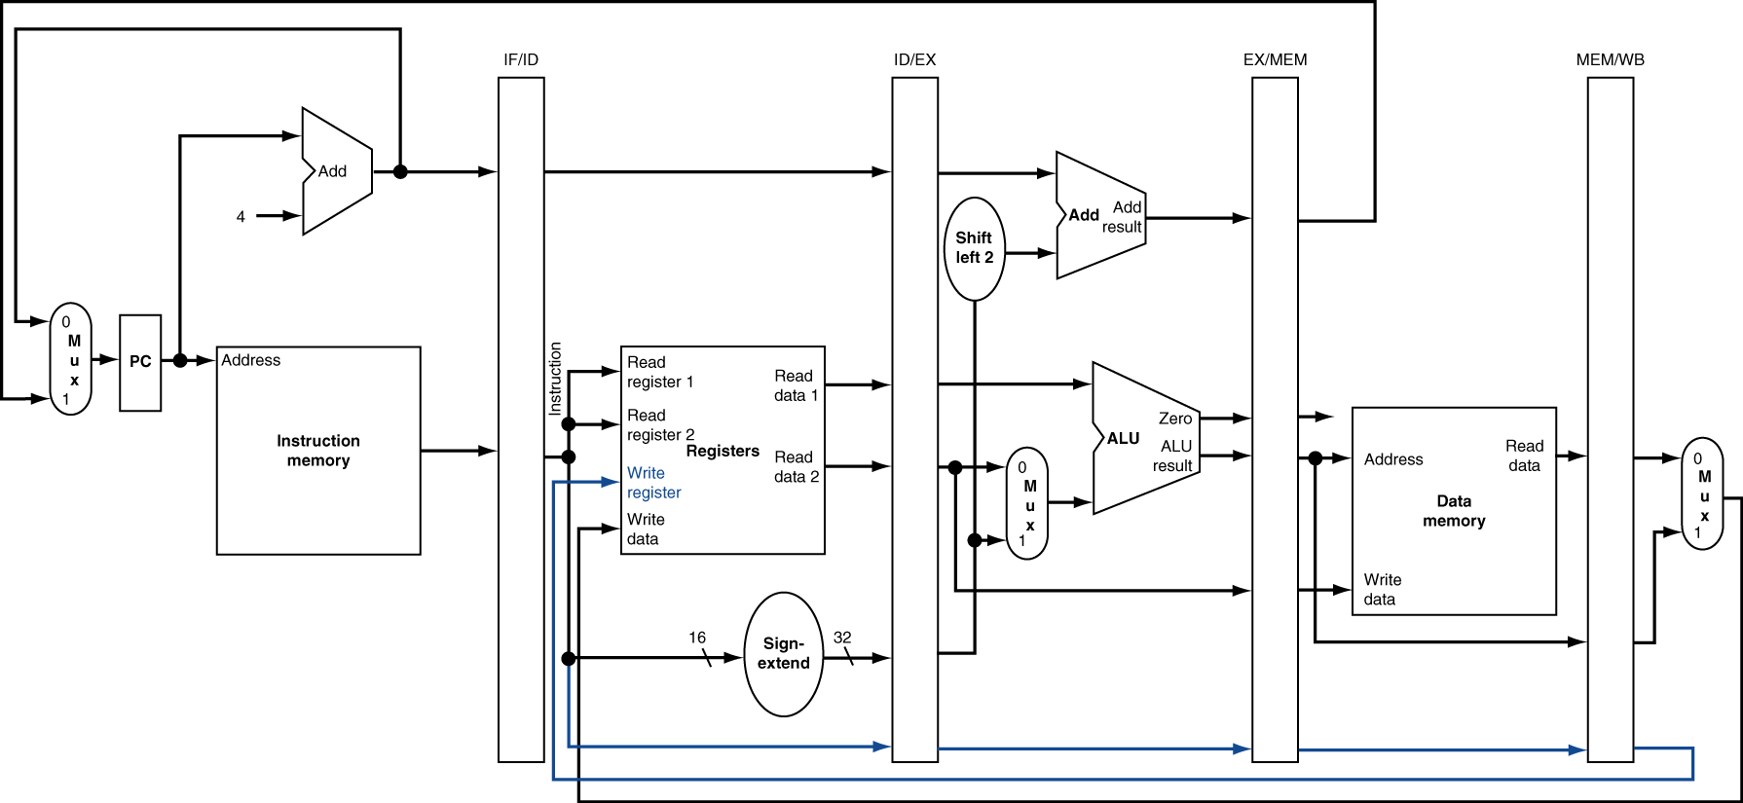
Corrected Datapath for Load

Slide 20
Pipelined Execution Representation
Time
IF
ID
EX
Mem
WB
IF
ID
EX
Mem
WB
IF
ID
EX
Mem
WB
IF
ID
EX
Mem
WB
IF
ID
EX
Mem
WB
IF
ID
EX
Mem
WB
Every instruction must take same number of steps, also called pipelinestages, so some will go idle sometimes

Slide 21
Graphical Pipeline Diagrams
rd
PC
instruction
memory
registers
rs
Data
memory
rt
ALU
+4
imm
2. Decode/
Register Read
1. Instruction
Fetch
5. Write Back
3. Execute
4. Memory
Use datapath figure below to represent pipeline
IF
ID
EX
Mem
WB
I$
Reg
ALU
D$
Reg

Slide 22
Graphical Pipeline Representation
(In Reg, right half highlight read, left half write)
Time (clock cycles)
I
n
s
t
r.
O
r
d
e
r
Load
I$
Reg
ALU
D$
Reg
Add
I$
Reg
ALU
D$
Reg
Store
I$
Reg
ALU
D$
Reg
Sub
I$
Reg
ALU
D$
Reg
Or
I$
Reg
ALU
D$
Reg

Slide 23
Pipeline Performance
Assume time for stages is
100ps for register read or write
200ps for other stages
What is pipelined clock rate?
Compare pipelined datapath with single-cycle datapath
Instr | Instr fetch | Register read | ALU op | Memory access | Register write | Total time
lw | 200ps | 100 ps | 200ps | 200ps | 100 ps | 800ps
sw | 200ps | 100 ps | 200ps | 200ps |  | 700ps
R-format | 200ps | 100 ps | 200ps |  | 100 ps | 600ps
beq | 200ps | 100 ps | 200ps |  |  | 500ps
Student Roulette?

Slide 24
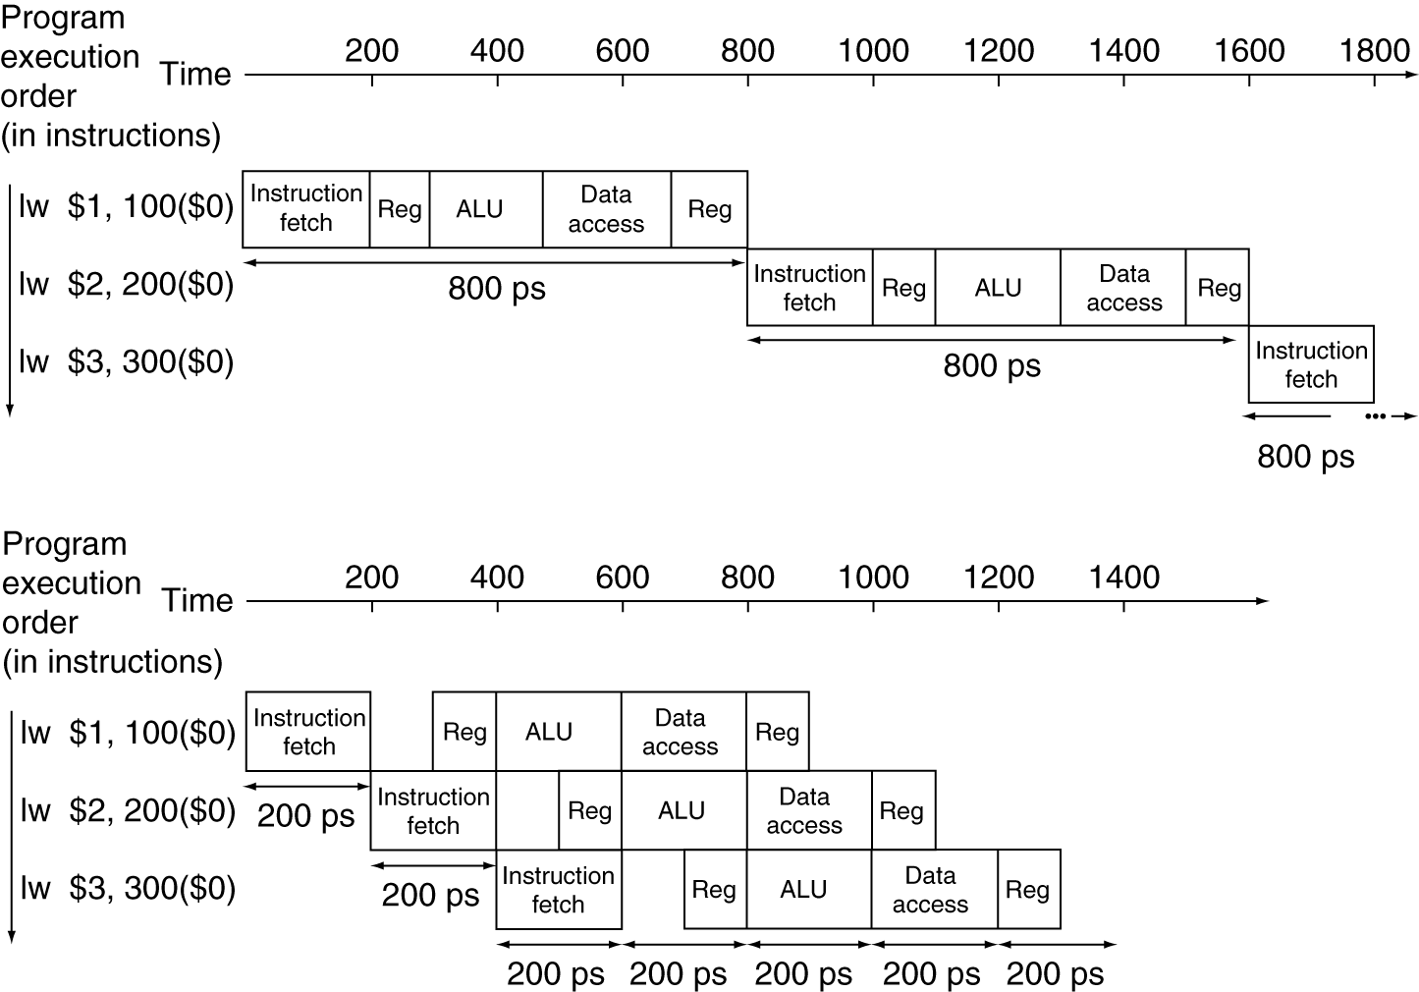
Pipeline Performance
Single-cycle (T_{c}= 800ps)
Pipelined (T_{c}= 200ps)

Slide 25
当前处理器的技术
超流水线技术
超标量技术
多核技术

